Slide 1
Matrix Representation And Homogeneous Coordinates

Slide 2
What is Matrix Representation
Matrix representation is a method used by a computer language to store matrices of more than one dimension in memory. Fortran and C use different schemes for their native arrays. Fortran uses "Column Major", in which all the elements for a given column are stored contiguously in memory. C uses "Row Major", which stores all the elements for a given row contiguously in memory.

Slide 3
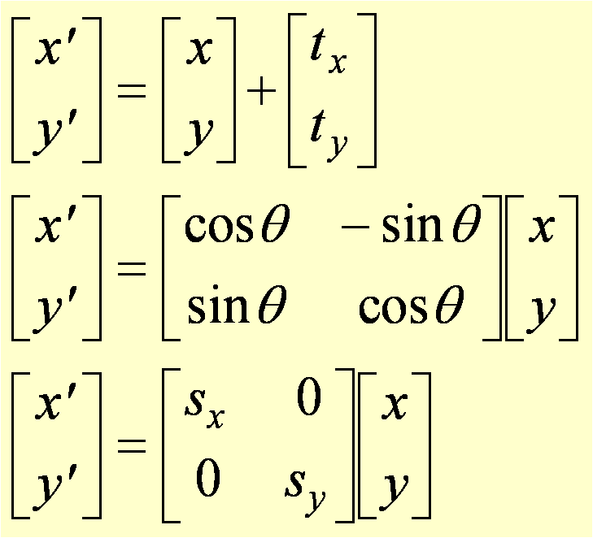
Matrix Representations
Translation
Rotation [Origin]
Scaling [Origin]

Slide 4
Matrix Representations
Two –dimensional transformations (translation , rotation
And scaling) can be expressed in the general matrix form,
P’ = M1.P + M2
Where
// P represents coordinate positions
// P’ represented as column vectors
// M1 is 2 by 2 array containing multiplicative factors
// M2 is a two-element column matrix containing
translation terms

Slide 5
Homogeneous Coordinates
To obtain square matrices an additional row was added to the matrix and an additional coordinate, the w-coordinate, was added to the vector for a point. In this way a point in 2D space is expressed in three-dimensional homogeneous coordinates.
This technique of representing a point in a space whose dimension is one greater than that of the point is called homogeneous representation. It provides a consistent, uniform way of handling affine transformations.

Slide 6
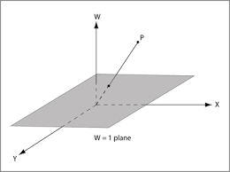
Homogeneous Coordinates
If we use homogeneous coordinates, the geometric transformations given above can be represented using only a matrix pre-multiplication.
A composite transformation can then be represented by a product of the corresponding matrices.

Slide 7
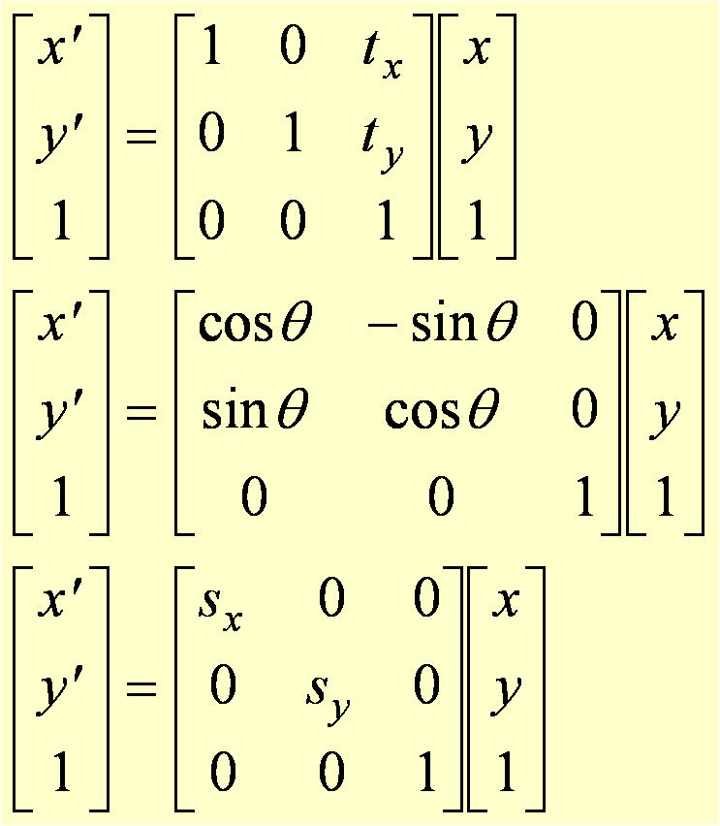
Homogeneous Coordinates
Translation
P’=TP
Rotation [O]
P’=RP
Scaling [O]
P’=SP

Slide 8
ThAnKu…….
By,
Ayyappa

